Slide 1
Performance Estimation

Slide 2
Topics Covered
Data Science – Types of Data, Steps
Statistics – Descriptive & Inferential (Estimation & Hypothesis Testing)
Vector Norms, Gradient Descent, Jacobian Matrix, Hessian Matrix
Regression (Establish Relationships Between Variables) – Linear & Non-linear, Simple & Multiple
Clustering (Formation of Groups Having Similar Characteristics)
Classification (Allotting an unknown parameter to a given class)
Performance Estimation – R², Confusion Matrix

Slide 3
Performance Estimation of a Classifier
Predictive accuracy works fine, when the classes are balanced
That is, every class in the data set are equally important
In fact, data sets with imbalanced class distributions are quite common in many real life applications
When the classifier classified a test data set with imbalanced class distributions then, predictive accuracy on its own is not a reliable indicator of a classifier’s effectiveness.
Example : Effectiveness of Predictive Accuracy
Given a data set of stock markets, we are to classify them as “good” and “worst”. Suppose, in the data set, out of 100 entries, 98 belong to “good” class and only 2 are in “worst” class.
With this data set, if classifier’s predictive accuracy is 0.98, a very high value!
Here, there is a high chance that 2 “worst” stock markets may incorrectly be classified as “good”
On the other hand, if the predictive accuracy is 0.02, then none of the stock markets may be classified as “good”

Slide 4
Performance Estimation of a Classifier
Thus, when the classifier classified a test data set with imbalanced class distributions, then predictive accuracy on its own is not a reliable indicator of a classifier’s effectiveness.
This necessitates an alternative metrics to judge the classifier.
Before exploring them, we introduce the concept of Confusion matrix.

Slide 5
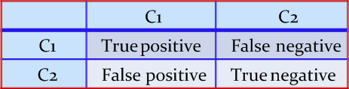
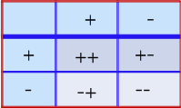
Confusion Matrix
A confusion matrix for a two classes (+, -) is shown below.
There are four quadrants in the confusion matrix, which are symbolized as below.
True Positive (TP: f₊₊) : The number of instances that were positive (+) and correctly classified as positive (+v).
False Negative (FN: f₊₋): The number of instances that were positive (+) and incorrectly classified as negative (-). It is also known as Type 2 Error.
False Positive (FP: f₋₊): The number of instances that were negative (-) and incorrectly classified as (+). This also known as Type 1 Error.
True Negative (TN: f₋₋): The number of instances that were negative (-) and correctly classified as (-).

Slide 6
Confusion Matrix
Note:
N_{p} = TP (f₊₊) + FN (f₊₋)
= is the total number of positive instances.
N_{n} = FP(f₋₊) + TN(f₋₋)
= is the total number of negative instances.
N = N_{p} + N_{n}
= is the total number of instances.
(TP + TN) denotes the number of correct classification
(FP + FN) denotes the number of errors in classification.
For a perfect classifier FP = FN = 0, that is, there would be no Type 1 or Type 2 errors.

Slide 7
Confusion Matrix
Example : Confusion matrix
A classifier is built on a dataset regarding Good and Worst classes of stock markets. The model is then tested with a test set of 10000 unseen instances. The result is shown in the form of a confusion matrix. The result is self explanatory.
Predicted Values
Class | Good | Worst | Total | Rate(%)
Good | 6954 | 46 | 7000 | 99.34
Worst | 412 | 2588 | 3000 | 86.27
Total | 7366 | 2634 | 10000 | 95.52
Actual Values
Predictive accuracy?

Slide 8
Confusion Matrix for Multiclass Classifier
Having m classes, confusion matrix is a table of size m×m , where, element at (i, j) indicates the number of instances of class i but classified as class j.
To have good accuracy for a classifier, ideally most diagonal entries should have large values with the rest of entries being close to zero.
Confusion matrix may have additional rows or columns to provide total or recognition rates per class.

Slide 9
Confusion Matrix for Multiclass Classifier
Example : Confusion matrix with multiple class
Following table shows the confusion matrix of a classification problem with six classes labeled as C₁, C₂, C₃, C₄, C₅ and C₆.
Class | C1 | C2 | C3 | C4 | C5 | C₆
C1 | 52 | 10 | 7 | 0 | 0 | 1
C2 | 15 | 50 | 6 | 2 | 1 | 2
C3 | 5 | 6 | 6 | 0 | 0 | 0
C4 | 0 | 2 | 0 | 10 | 0 | 1
C5 | 0 | 1 | 0 | 0 | 7 | 1
C₆ | 1 | 3 | 0 | 1 | 0 | 24
Predictive accuracy?

Slide 10
Confusion Matrix for Multiclass Classifier
In case of multiclass classification, sometimes one class is important enough to be regarded as positive with all other classes combined togather as negative.
Thus a large confusion matrix of m*m can be concised into 2*2 matrix.
Example : m×m CM to 2×2 CM
For example, consider CM of size 2×2
How we can calculate the predictive accuracy of the classifier model in this case?
Class | + | -
+ | 52 | 18
- | 21 | 123

Slide 11
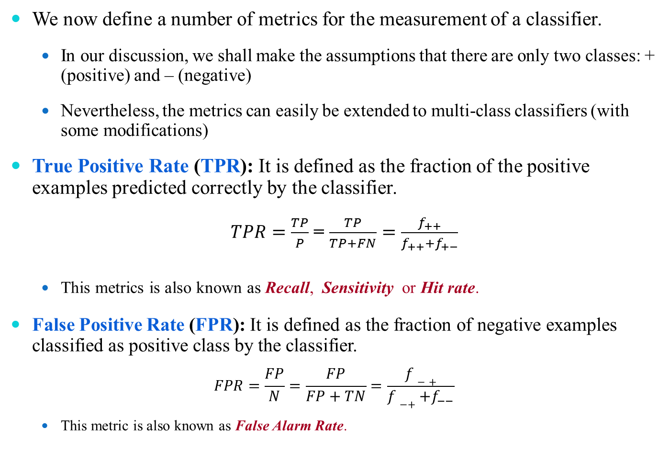
Performance Evaluation Metrics
We now define a number of metrics for the measurement of a classifier.
In our discussion, we shall make the assumptions that there are only two classes: + (positive) and – (negative)
Nevertheless, the metrics can easily be extended to multi-class classifiers (with some modifications)
True Positive Rate (TPR): It is defined as the fraction of the positive examples predicted correctly by the classifier.
$TPR=\frac{TP}{P}$ = $\frac{TP}{TP+FN}=\frac{f_{++}}{f_{++}+f_{+−}}$
This metrics is also known as Recall, Sensitivity or Hit rate.
False Positive Rate (FPR): It is defined as the fraction of negative examples classified as positive class by the classifier.
$$FPR=\frac{FP}{N}=\frac{FP}{FP+TN}=\frac{f−+}{f−++f_{−−}}$$
This metric is also known as False Alarm Rate.

Slide 12
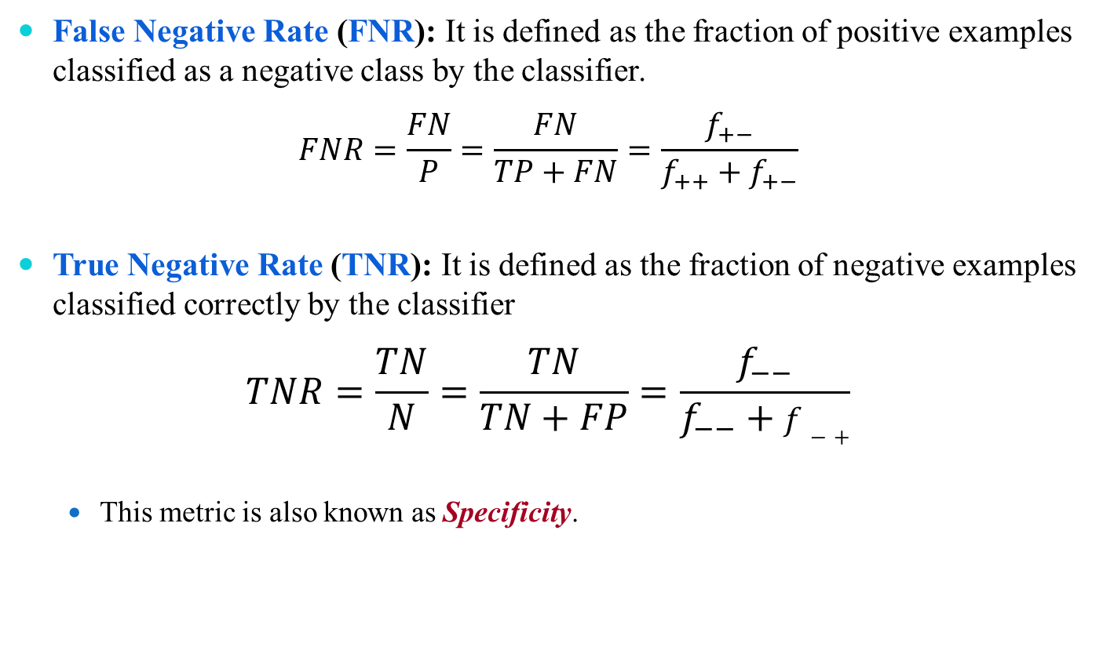
Performance Evaluation Metrics
False Negative Rate (FNR): It is defined as the fraction of positive examples classified as a negative class by the classifier.
$$FNR=\frac{FN}{P}=\frac{FN}{TP+FN}=\frac{f_{+−}}{f_{++}+f_{+−}}$$
True Negative Rate (TNR): It is defined as the fraction of negative examples classified correctly by the classifier
$$TNR=\frac{TN}{N}=\frac{TN}{TN+FP}=\frac{f_{−−}}{f_{−−}+f−+}$$
This metric is also known as Specificity.

Slide 13
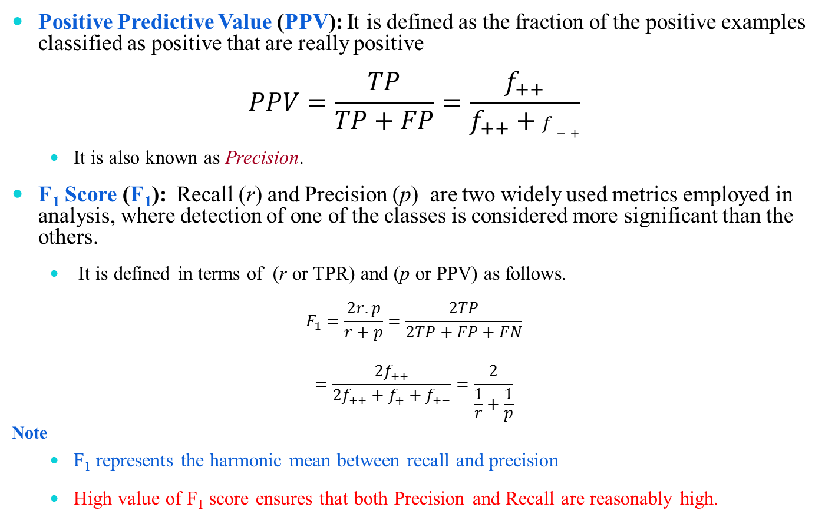
Performance Evaluation Metrics
Positive Predictive Value (PPV): It is defined as the fraction of the positive examples classified as positive that are really positive
$$PPV=\frac{TP}{TP+FP}=\frac{f_{++}}{f_{++}+f−+}$$
It is also known as Precision.
F₁ Score (F₁): Recall (r) and Precision (p) are two widely used metrics employed in analysis, where detection of one of the classes is considered more significant than the others.
It is defined in terms of (r or TPR) and (p or PPV) as follows.
$$F_{1}=\frac{2r.p}{r+p}=\frac{2TP}{2TP+FP+FN}$$
$$=\frac{{2f}_{++}}{{2f}_{++}+f_{∓}+f_{+−}}=\frac{2}{\frac{1}{r}+\frac{1}{p}}$$
Note
F₁ represents the harmonic mean between recall and precision
High value of F₁ score ensures that both Precision and Recall are reasonably high.

Slide 14
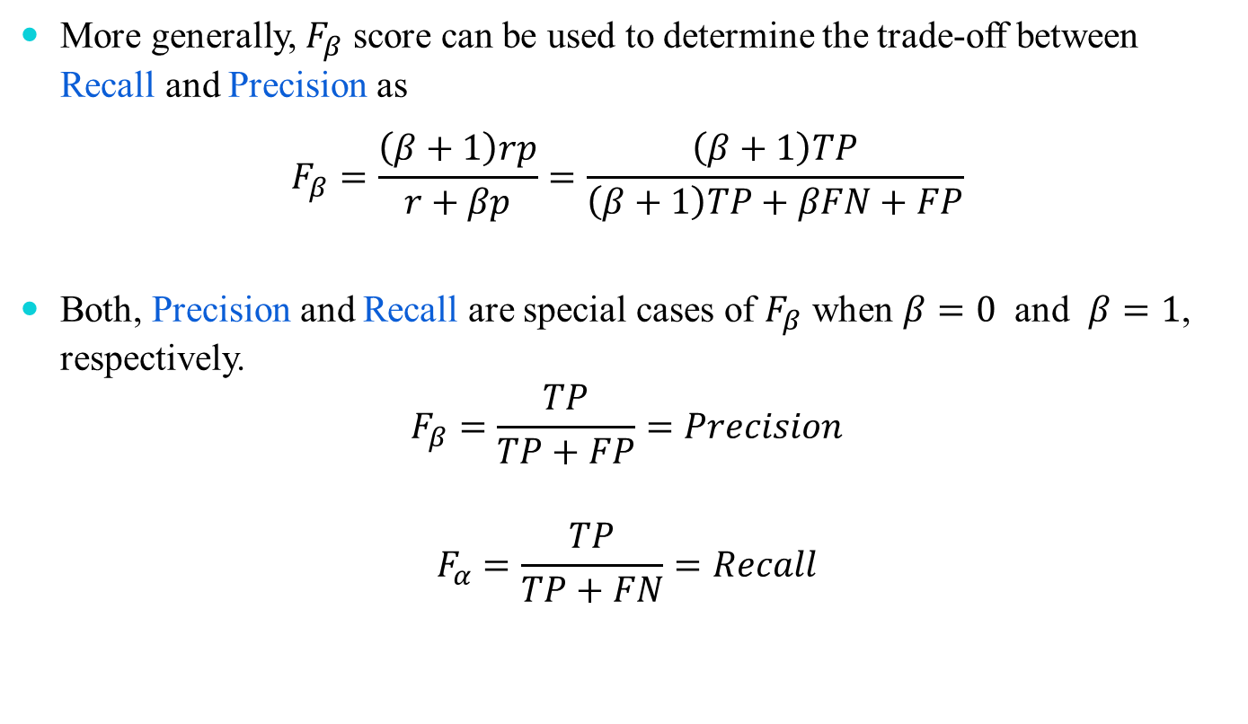
Performance Evaluation Metrics
More generally, $F_{β}$ score can be used to determine the trade-off between Recall and Precision as
$$F_{β}=\frac{\left(β+1\right)rp}{r+βp}=\frac{\left(β+1\right)TP}{\left(β+1\right)TP+βFN+FP}$$
Both, Precision and Recall are special cases of $F_{β}$ when $β=0$ and $β=1$, respectively.
$$F_{β}=\frac{TP}{TP+FP}=Precision$$
$$F_{α}=\frac{TP}{TP+FN}=Recall$$

Slide 15
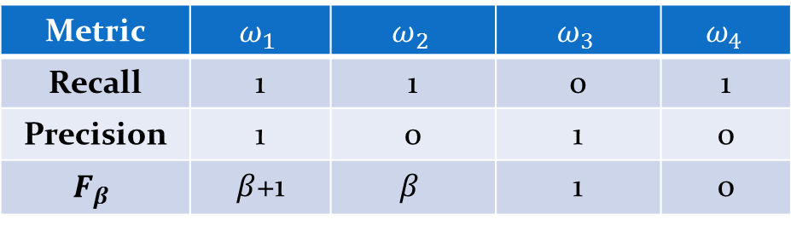
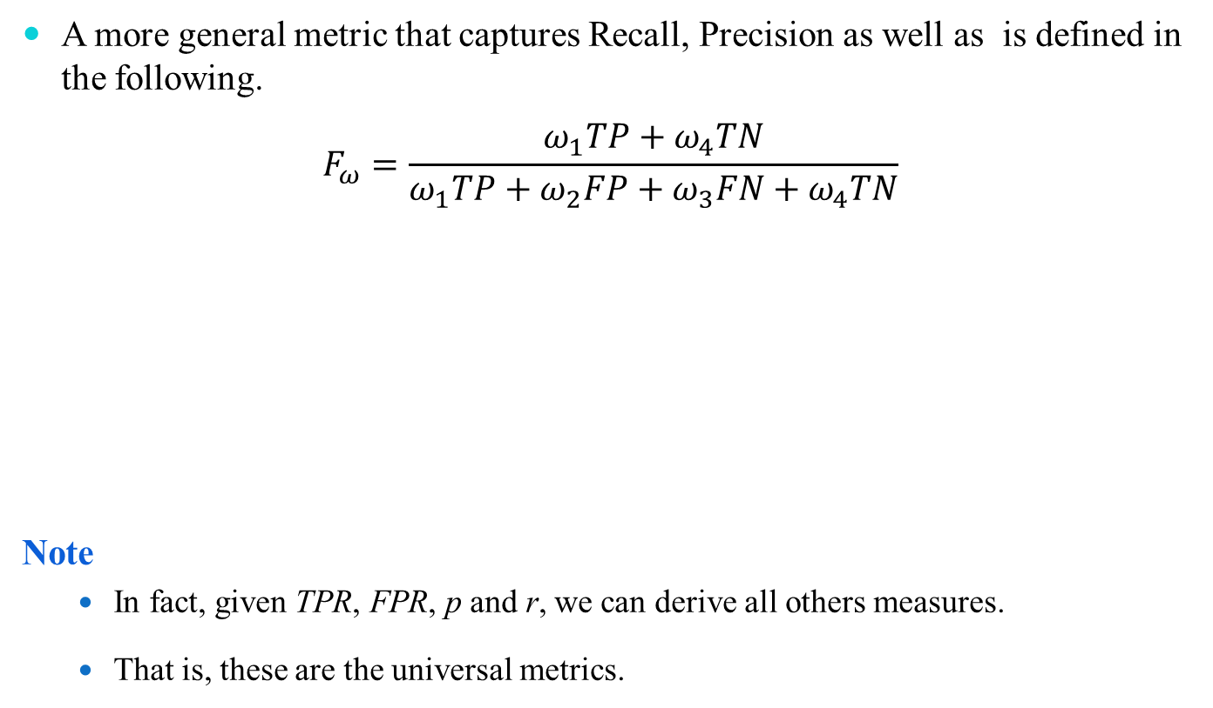
Performance Evaluation Metrics
A more general metric that captures Recall, Precision as well as is defined in the following.
$$F_{ω}=\frac{ω_{1}TP+ω_{4}TN}{ω_{1}TP+ω_{2}FP+ω_{3}FN+ω_{4}TN}$$
Note
In fact, given TPR, FPR, p and r, we can derive all others measures.
That is, these are the universal metrics.
Metric | $$ω_{1}$$ | $$ω_{2}$$ | $$ω_{3}$$ | $$ω_{4}$$
Recall | 1 | 1 | 0 | 1
Precision | 1 | 0 | 1 | 0
$$F_{β}$$ | $β$+1 | $$β$$ | 1 | 0

Slide 16
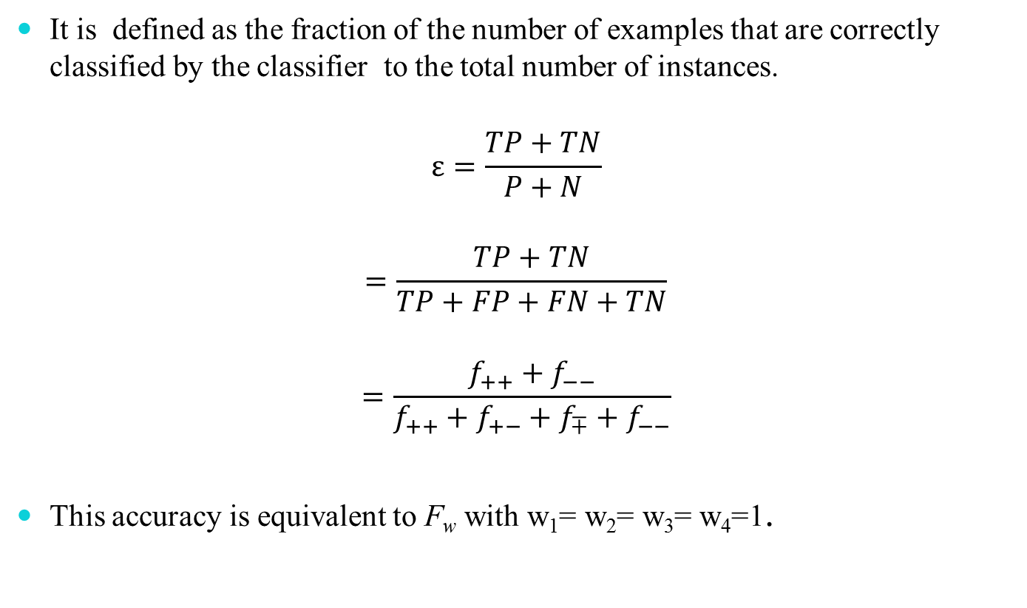
Predictive Accuracy (ε)
It is defined as the fraction of the number of examples that are correctly classified by the classifier to the total number of instances.
$$ε=\frac{TP+TN}{P+N}$$
$$=\frac{TP+TN}{TP+FP+FN+TN}$$
$$=\frac{f_{++}+f_{−−}}{f_{++}+f_{+−}+f_{∓}+f_{−−}}$$
This accuracy is equivalent to F_{w} with w₁= w₂= w₃= w₄=1.

Slide 17


Error Rate ($\overline{\text{ε}}$)
The error rate $\overline{\text{ε}}$ is defined as the fraction of the examples that are incorrectly classified.
$$\overline{\text{ε}}=\frac{FP+FN}{P+N}$$
$$=\frac{FP+FN}{TP+TN+FP+FN}$$
$$=\frac{f_{+−}+f−+}{f_{++}+f_{+−}+f− ++f_{−−}}$$
Note
$\overline{\overline{\text{ε}}}=1−ε$.

Slide 18

Accuracy, Sensitivity and Specificity
Predictive accuracy ($ε$) can be expressed in terms of sensitivity and specificity.
We can write
$$ε =\frac{TP+TN}{TP+FP+FN+TN}$$
$$=\frac{TP+TN}{P+N}$$
$$ε= \frac{TP}{P}×\frac{P}{P+N}+\frac{TN}{N}×\frac{N}{P+N}$$
Thus, $ε=Sensitivity×\frac{P}{P+N}+Specificity×\frac{N}{P+N}$

Slide 19
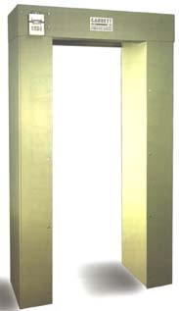
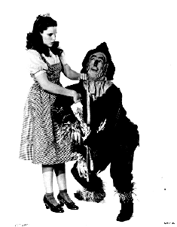

Two Types of Error
False positive (“false alarm”), FP
alarm sounds but person is not carrying metal
False negative (“miss”), FN
alarm doesn’t sound but person is carrying metal

Slide 20
Class | Ham | Spam
Ham | 1202 | 5
Spam | 29 | 154

Slide 21
True | Predicted
 | pos | neg
pos | 40 | 60
neg | 30 | 70
True | Predicted
 | pos | neg
pos | 70 | 30
neg | 50 | 50
True | Predicted
 | pos | neg
pos | 60 | 40
neg | 20 | 80
Classifier I Classifier II Classifier III
Classifier 1
TP = 0.4
FP = 0.3
Classifier 2
TP = 0.7
FP = 0.5
Classifier 3
TP = 0.6
FP = 0.2

Slide 22
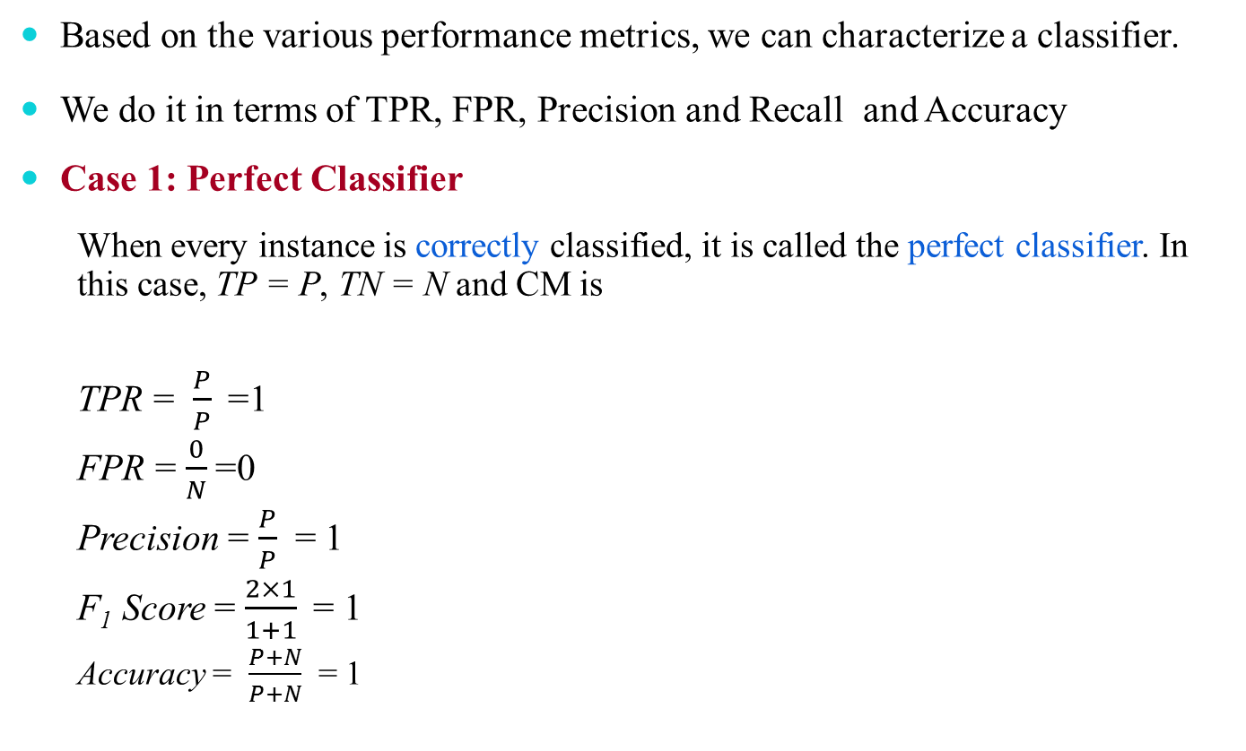
Analysis with Performance Measurement Metrics
Based on the various performance metrics, we can characterize a classifier.
We do it in terms of TPR, FPR, Precision and Recall and Accuracy
Case 1: Perfect Classifier
When every instance is correctly classified, it is called the perfect classifier. In this case, TP = P, TN = N and CM is
TPR = $\frac{P}{P}$=1
FPR = $\frac{0}{N}$=0
Precision = $\frac{P}{P}$ = 1
F₁ Score = $\frac{2×1}{1+1}$= 1
Accuracy = $\frac{P+N}{P+N}$ = 1
 |  | Predicted Class
 |  | + | -
Actual class | + | P | 0
 | - | 0 | N

Slide 23
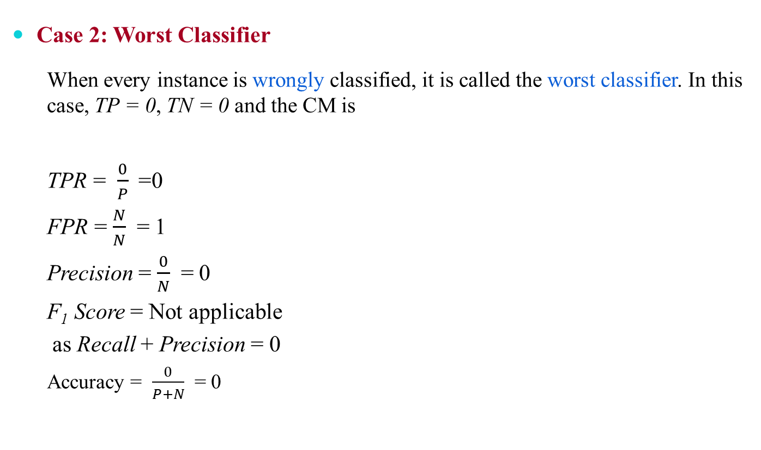
Analysis with Performance Measurement Metrics
Case 2: Worst Classifier
When every instance is wrongly classified, it is called the worst classifier. In this case, TP = 0, TN = 0 and the CM is
TPR = $\frac{0}{P}$=0
FPR = $\frac{N}{N}$ = 1
Precision = $\frac{0}{N}$ = 0
F₁ Score = Not applicable
as Recall + Precision = 0
Accuracy = $\frac{0}{P+N}$ = 0
 |  | Predicted Class
 |  | + | -
Actual class | + | 0 | P
 | - | N | 0

Slide 24

Analysis with Performance Measurement Metrics
Case 3: Ultra-Liberal Classifier
The classifier always predicts the + class correctly. Here, the False Negative (FN) and True Negative (TN) are zero. The CM is
TPR = $\frac{P}{P}$= 1
FPR = $\frac{N}{N}$ = 1
Precision = $\frac{P}{P+N}$
F₁ Score = $\frac{2P}{2P+N}$
Accuracy = $\frac{P}{P+N}$ = 0
 |  | Predicted Class
 |  | + | -
Actual class | + | P | 0
 | - | N | 0

Slide 25
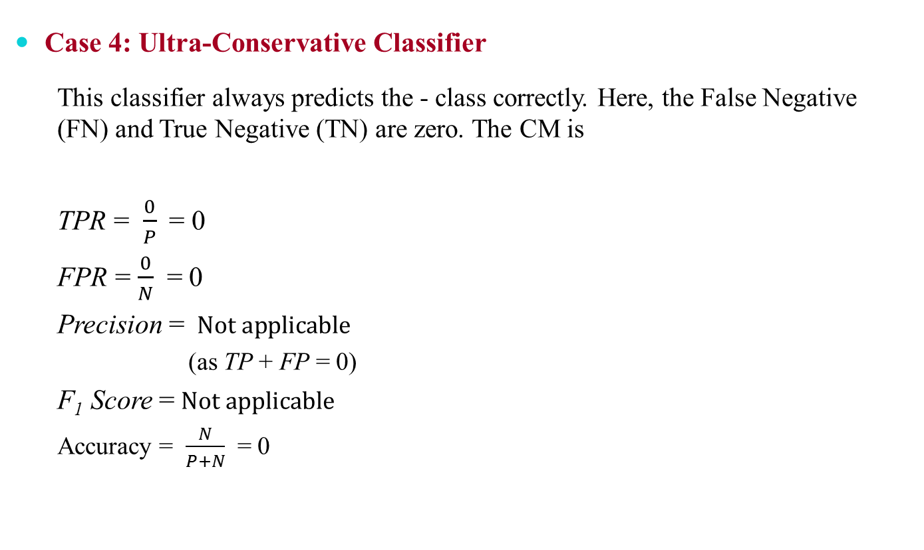
Analysis with Performance Measurement Metrics
Case 4: Ultra-Conservative Classifier
This classifier always predicts the - class correctly. Here, the False Negative (FN) and True Negative (TN) are zero. The CM is
TPR = $\frac{0}{P}$= 0
FPR = $\frac{0}{N}$ = 0
Precision = $Not applicable$
(as TP + FP = 0)
F₁ Score =$Not applicable$
Accuracy = $\frac{N}{P+N}$ = 0
 |  | Predicted Class
 |  | + | -
Actual class | + | 0 | p
 | - | 0 | N

Slide 26
Predictive Accuracy versus TPR and FPR
One strength of characterizing a classifier by its TPR and FPR is that they do not depend on the relative size of P and N.
The same is also applicable for FNR and TNR and others measures from CM.
In contrast, the Predictive Accuracy, Precision, Error Rate, F₁ Score, etc. are affected by the relative size of P and N.
FPR, TPR, FNR and TNR are calculated from the different rows of the CM.
On the other hand Predictive Accuracy, etc. are derived from the values in both rows.
This suggests that FPR, TPR, FNR and TNR are more effective than Predictive Accuracy, etc.

Slide 27
Thank You

